Slide 1
Unit -1
Relationship between the pixels – Distance Measure

Slide 2
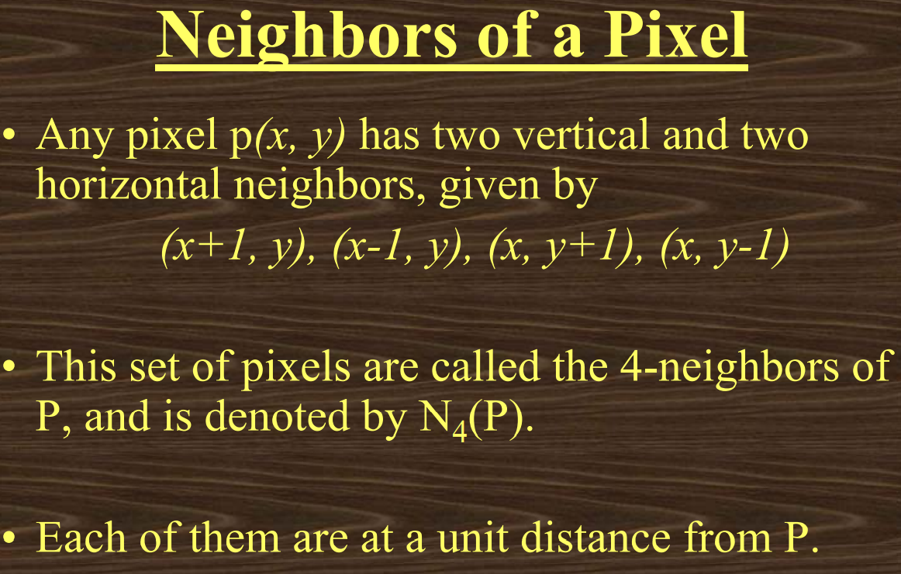

Slide 3
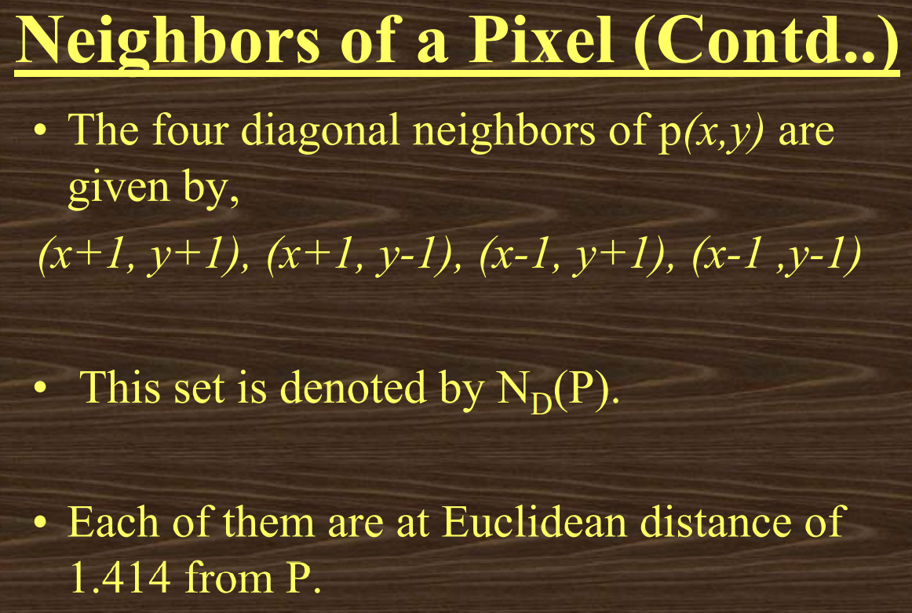

Slide 4
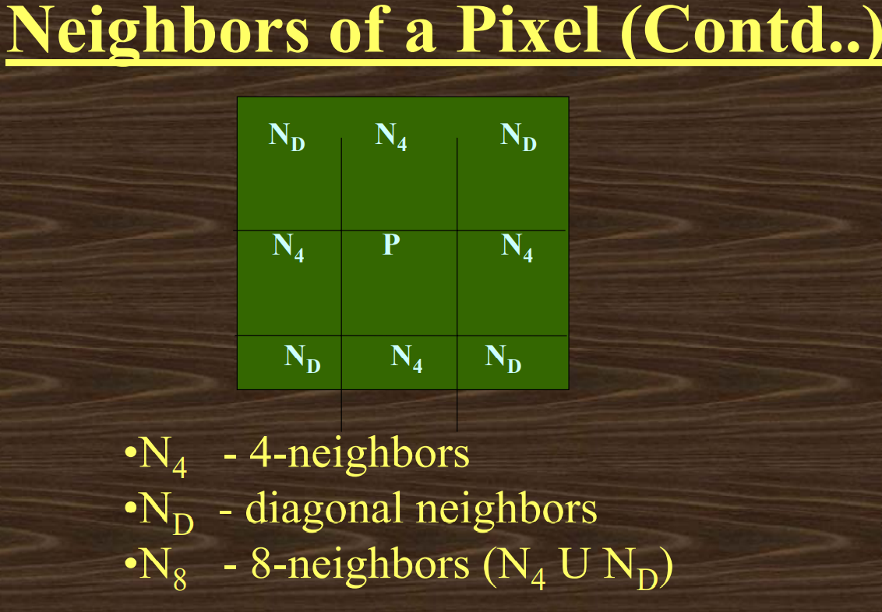

Slide 5
Neighbors of a Pixel
The points N_{D}(P) and N₄(P) are together known as 8-neighbors of the point P, denoted by N₈(P).
Two pixels are connected if they are neighbors and their gray levels satisfy some specified criterion of similarity.
For example, in a binary image two pixels are connected if they are 4-neighbors and have same value (0/1)

Slide 6
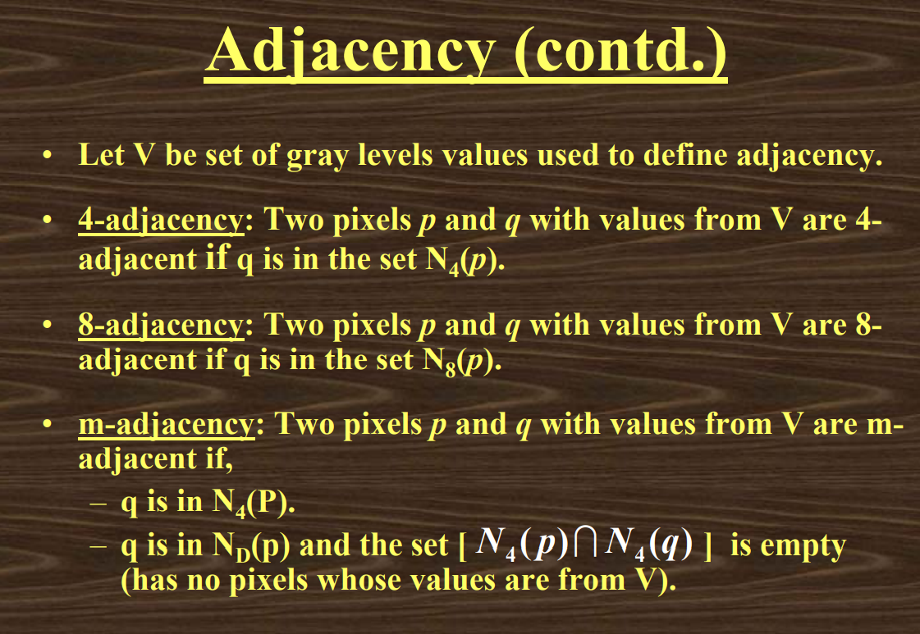

Slide 7
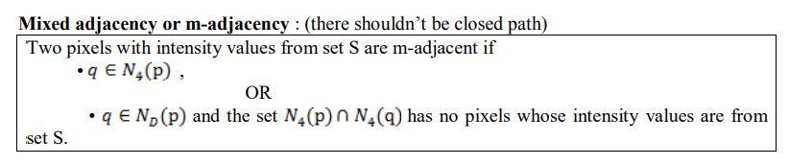
m-adjacency
Mixed adjacency is a modification of 8-adjacency and is used to eliminate the multiple path connections that often arise when 8-adjacency is used.

Slide 8
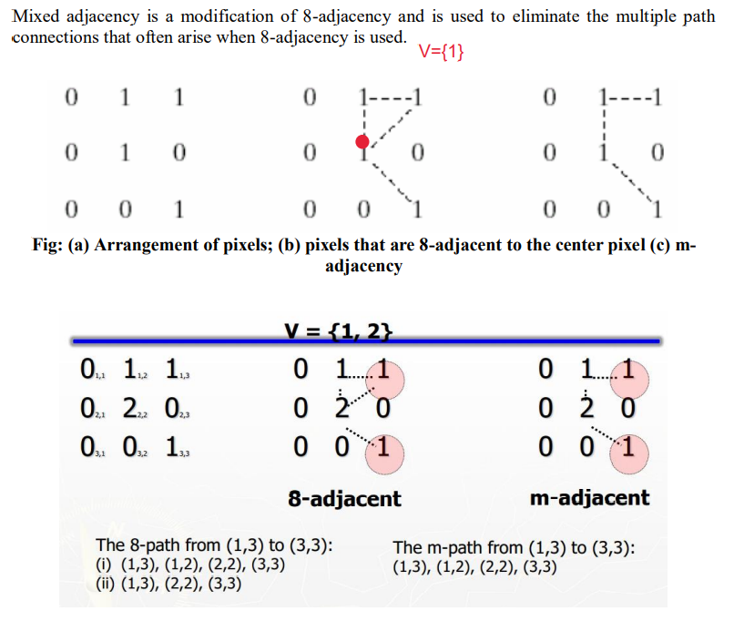

Slide 9
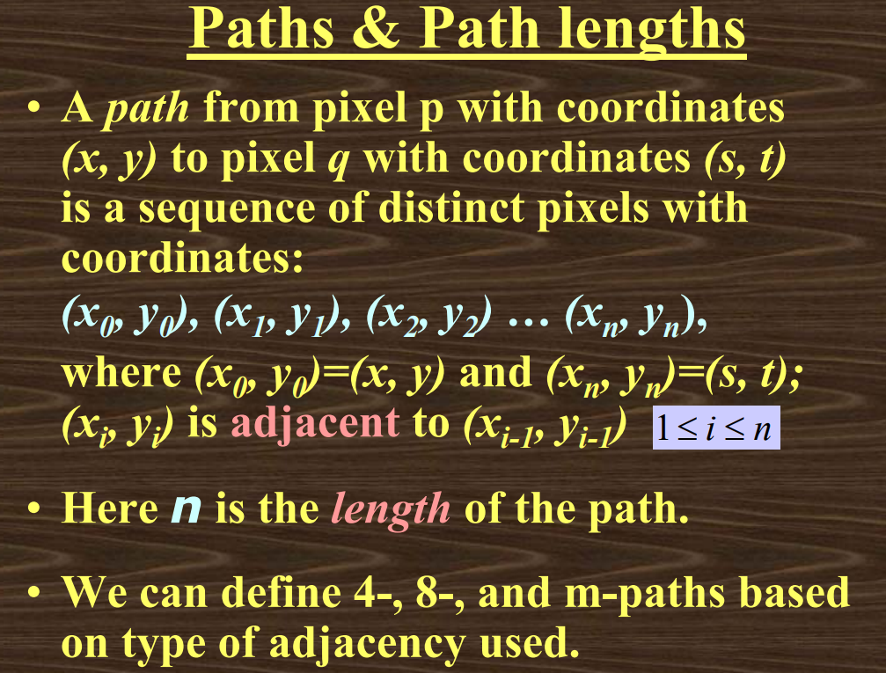

Slide 10
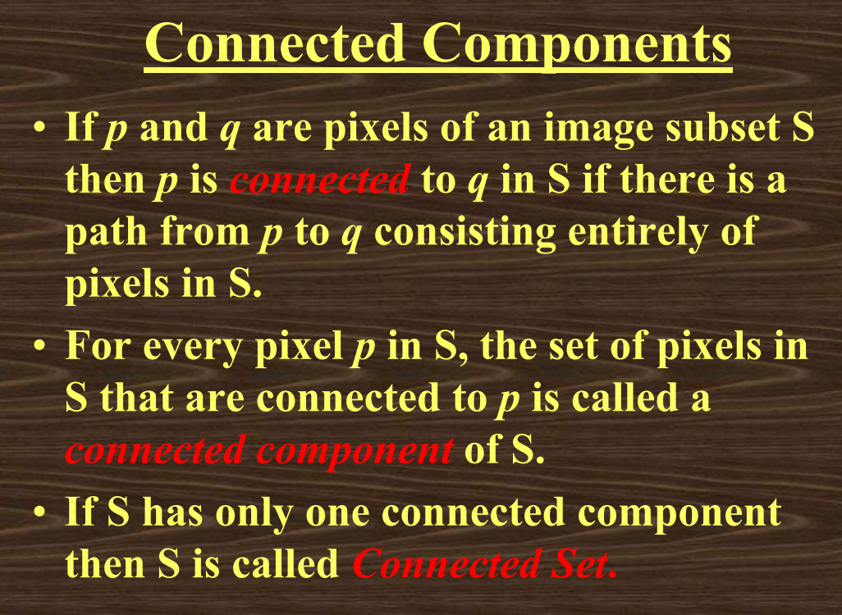

Slide 11
Regions and Boundaries
A Region R is a subset of pixels in an image such that all pixels in R form a connected component.
A Boundary of a region R is the set of pixels in the region that have one or more neighbors that are not in R.
If R happens to be an entire image, then its boundary is defined as the set of pixels in the first and last rows and columns of the image.

Slide 12
Distance measures
Given pixels p, q and z with coordinates (x, y), (s, t), (u, v) respectively, the distance function D has following properties:
a. D(p, q) ≥ 0 [D(p, q) = 0, iff p = q]
b. D(p, q) = D(q, p)
c. D(p, z) ≤ D(p, q) + D(q, z)

Slide 13
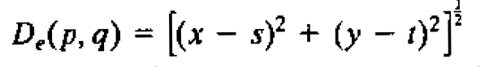
Euclidean Distance :
The distance between two pixels p and q with coordinates (x, y), (s, t) respectively can be formulated in several ways:
Euclidean Distance
For this distance measure, the pixels having a distance less than or equal to some value ‘r‘ from (x,y) are the points contained in a disk of radius ‘r‘ centered at (x,y).
Set of points S = {q| D(p,q) ≤ r} are the points contained in a disk of radius r centered at p.

Slide 14
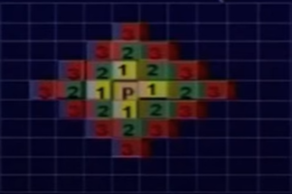
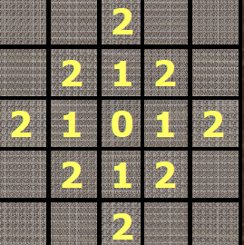
City – Block Distance
The D₄ distance also called city-block (Manhattan) distance.
D₄(p, q) = |x-s| + |y-t|
In this case, the pixels having a D₄ distance from (x,y) less than or equal to some value ‘r’ form a diamond centered at (x,y).
For eg, the pixels with D₄ distance ≤ 2 from (x,y) (the center point) form the following contours of constant distance:
The pixels with D₄ =1 are the 4-neighbour of (x,y)

Slide 15
City – Block Distance
The city block distance transform is a basic operation in computer vision, pattern recognition and robotics.
For instance, if the black pixels represent obstacles, then d_{ij} tells us how far the point (i, j) is from these obstacles.
This information is useful when one tries to move a robot in the free space hit pixels of the image and to keep it away from the obstacles.

Slide 16
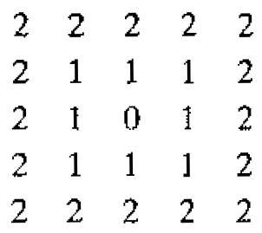
Chess Board Distance:
D₈ distance or chess board distance is defined as –
D₈(p,q) = max(|x-s|,|y-t|)
In this case, the pixels having a D₈ distance from (x,y) less than or equal to some value ‘r’ form a square centered at (x,y).
For eg, the pixels with D₈ distance ≤ 2 from (x,y) (the center point) form the following contours of constant distance:
The pixels with D₈ =1 are the 8-neighbour of (x,y)

Slide 17
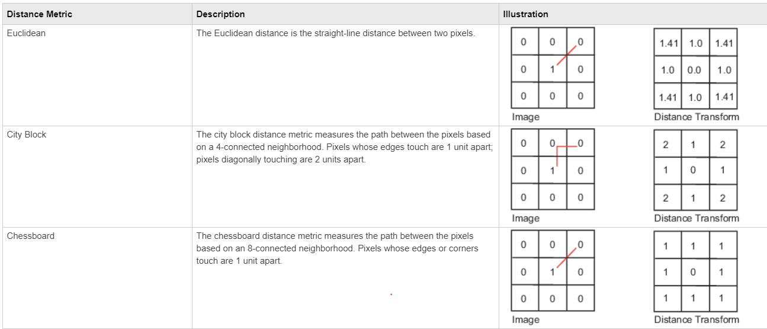

Slide 18
Arithmetic/Logic Operations:
Arithmetic operations between images are array operations, means that arithmetic operations are carried out between corresponding pixel pairs.
Addition : p + q
Subtraction: p – q
Multiplication: p*q
Division: p/q
AND: p AND q
OR : p OR q
Complement: NOT(q)

Slide 19
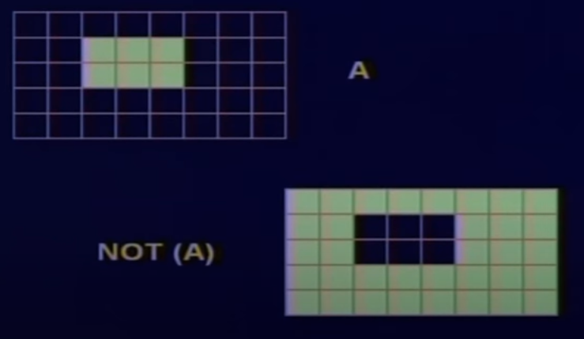
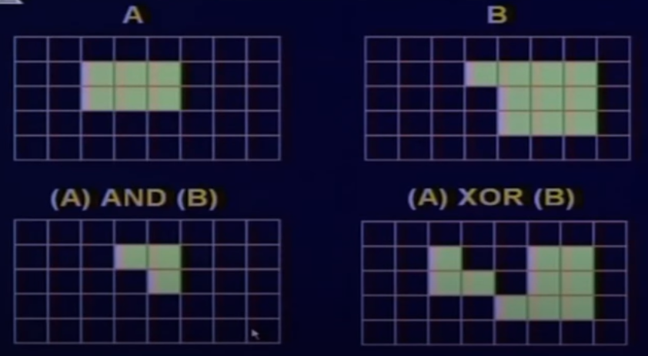
Logical Operators
The XOR logical operation, or exclusive or, takes two Boolean operands and returns true if and only if the operands are different. Thus, it returns false if the two operands have the same value.
So, the XOR operator can be used, for example, when we have to check for two conditions that can't be true at the same time.

Slide 20
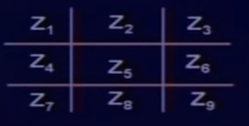
Neighbourhood Operations
The intensity value at a particular pixel may be replaced by a function of the intensity values of the pixels which are neighbours of that particular pixel.
Z=1/9(Z₁+ Z₂+ Z₃+ Z₄+ Z₅+ Z₆+ Z₇+ Z₈+ Z₉)=Average
Averaging can be used to remove noise from a noisy image.
A 3X3 image

Slide 21
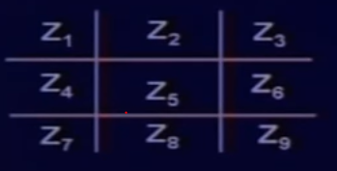
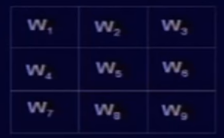
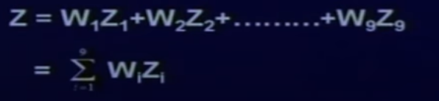
Generalize averaging op with Templates
Put this template on the original image in such a way that the pixel at which we want to replace the value coincide with the centre of the template.
Then at a particular point, we replace the value with the weighted sum of the values taken from the image and the corresponding point from the template
Value will be given by -

Slide 22
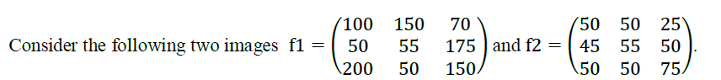
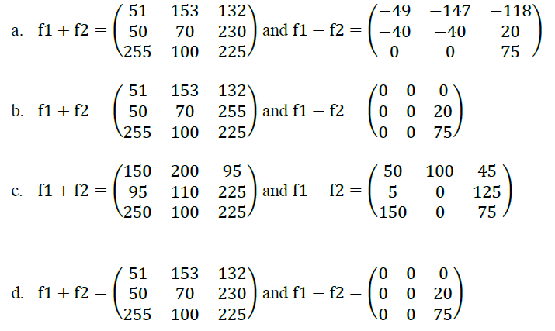
NPTEL Online Certification - Questions
1.
The addition and subtraction of images are given by f1+f2 and f1−f2 . Assume both the images are of the 8-bit integer type.

Slide 23
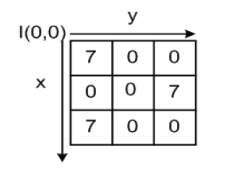
NPTEL Online Certification - Questions
In the following 3x3 image I(x, y), which of the option is true?
a) I(1, 1) and I(0, 1) are m-connected
b) I(1, 1) and I(0, 1) are 8-connected
c) Both a and b
d) None of the above

Slide 24
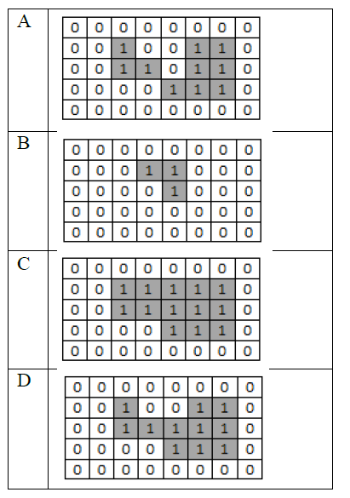
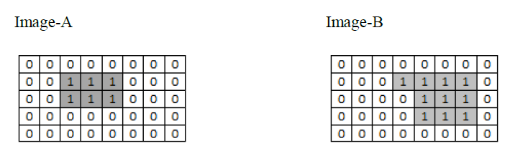
NPTEL Online Certification - Questions
Find the value of logical operation OR for the binary images A and B (A OR B). Assume 1 to be foreground and 0 to be background pixels.

Slide 25
NPTEL Online Certification - Questions
Compute the Euclidean Distance (D1), City-block Distance (D2) and Chessboard distance (D3) for points p and q, where p and q be (1, 2, 3) and (1, 5, 7) respectively. Give answer in the form (D1, D2, D3).
a) (5, 3, 4)
b) (5, 4, 3)
c) (7, 5, 4)
d) (5, 7, 4)

Slide 26
NPTEL Questions
Compute the Euclidean Distance (D1), City-block Distance (D2) and Chessboard distance (D3) for points p and q, where p and q be (3, 2, 3) and (2,3, 7) respectively. Give answer in the form (D1, D2, D3).
( 3√2, 3, 4)
( 3√2, 6, 4)
( 3√2, 4, 3)
( 3√3, 2, 3)

Slide 27
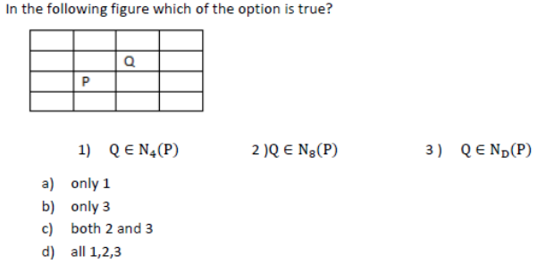
NPTEL Question
Answer- c

Slide 28
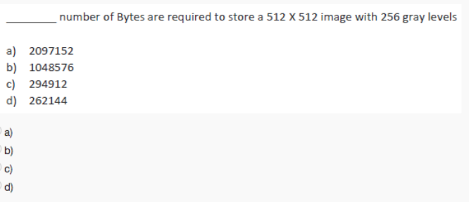
Ans: d

Slide 29
p(x-1, y-1) | p(x-1, y) | p(x-1, y+1)
p(x, y-1) | p(x,y) | p(x,y+1)
p(x+1,y-1) | p(x+1, y) | p(x+1, y+1)

Slide 30
 |  |  |  |  |  |  | 4 | 4 | 2
 |  |  |  |  |  | 15 | 4 | 4 | 2
 |  |  |  |  |  | 4 | 4 | 4 | 2
 |  |  |  |  |  |  | 4 | 5 | 2
 |  |  |  |  |  |  | 4 | 4 | 2
 |  |  |  |  |  |  | 4 | 4 | 2
 |  |  |  |  |  |  | 4 | 4 | 2
 |  |  |  |  |  |  | 4 | 4 | 2

Slide 31
1 | 2 | 1
2 | 1 | 2
1 | 2 | 1
100 | 120 | 10 | 10 | 120 | 120
100 | 120 | 10 | 120 | 120 | 120
100 | 120 | 10 | 120 | 120 | 120
100 | 120 | 10 | 120 | 10 | 120
100 | 120 | 10 | 120 | 120 | 120
100 | 120 | 10 | 120 | 120 | 120

